Slide 1
Dhaka University Club Management System
SE406: Software Requirement Specification & Analysis

Slide 2
Presented To
Dr. Kazi Muheymin-Us-Sakib
Professor
Institute of Information Technology
University of Dhaka

Slide 3
Presented by
Group-3
4th Semester, BSSE 07th Batch
Institute of Information Technology
University of Dhaka
Members | Roll
Shuvo Saha | 705
Jarifa Khatun Moitry | 710
Md. Aquib Azmain | 718
Abu Rafe Md. Jamil | 722
Sabbir Hussain Meraj | 726
Syed Fatiul Huq | 732

Slide 4
Inception
Listing Stakeholders
Recognizing Multiple Viewpoints
Working Towards Collaboration
Requirements Questionnaire

Slide 5
Elicitation
Collaborative Requirements Gathering
Quality Function Deployment
Usage Scenario

Slide 6
Scenario Based model

Slide 7
Scenario based modeling
Scenario based modeling is for better understanding of the problem.
Scenario base modeling consists of use-case, activity diagram and swimlane diagram.

Slide 8
Name: Authentication ID: CMS-L-1.1 Primary Actors: AM, GM, CM,Non-member Secondary Actors: Bank
Next

Slide 9
Sign in
Use Case Diagram
Scenario based modeling
Member/CM enter DUCEIN or username and password to login to DUCMS. She will be allowed to enter into the system upon entering correct credentials.
If Member/CM given Username or password is wrong for the fourth time then allow her to reset or recover the password and username through email.
Activity Diagram
Swimlane Diagram

Slide 10
Name: Sign in ID: CMS-L-1.1.1 Primary Actors: AM,GM,CM
Back

Slide 11
Activity Diagram 1.1.1:
Sign in
Back

Slide 12
New member registration
Use Case Diagram
Scenario based modeling
Two types of members: General Members (GM) and Associate Members (AM).
General members are either university faculty members or officers.
AMs are outsiders.
Activity Diagram
Swimlane Diagram

Slide 13
Name: Registration ID: CMS-L-1.1.2 Primary Actors: Non-member Secondary Actors: Bank, CM, AM, GM
Back

Slide 14
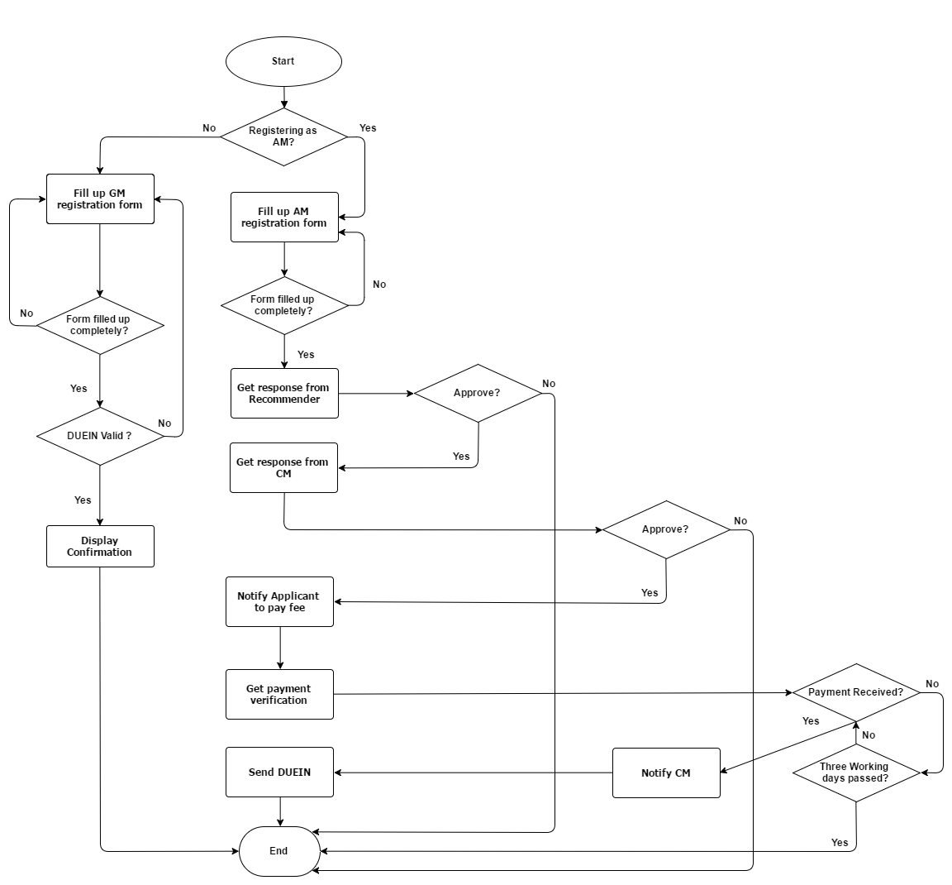
Activity Diagram 1.1.2:
Registration
Back

Slide 15

Swimlane Diagram 1.1.2:
Registration
Image

Slide 16
Ordering Food
Use Case Diagram
Scenario based modeling
Members can order food by logging into their own device or a dedicated electronic device in the club premises.
They can view a menu complete with food list and associate information.
They can add food to, edit, cancel or submit the cart.
Member can login before or after ordering. Order cannot be completed with member authentication
Activity Diagram
Swimlane Diagram

Slide 17
Name: Ordering Food ID: CMS-L-1.2 Primary Actors: AM, GM

Slide 18
Activity Diagram 1.2:
Ordering Food

Slide 19
Swimlane Diagram 1.2:
Ordering Food

Slide 20
Booking community space
Use Case Diagram
Scenario based modeling
Club space is rented out for community events only on Friday of every week between 10:00 am to 4:30 pm.
Every application made by a non-member is first approved by the recommender (existing member of DUC) and then by the Club Manager.
Upon approval, the applicant is notified to pay booking fees.
The space is allocated at desired date, and applicant is notified, after payment has been verified by the bank.
Activity Diagram
Swimlane Diagram

Slide 21
Name: Booking Community Space for Events ID: CMS-L-1.3 Primary Actors: AM,GM, Non-member, CM Secondary Actor: Bank
Back

Slide 22
No
Activity Diagram 1.3:
Booking Space
Back

Slide 23
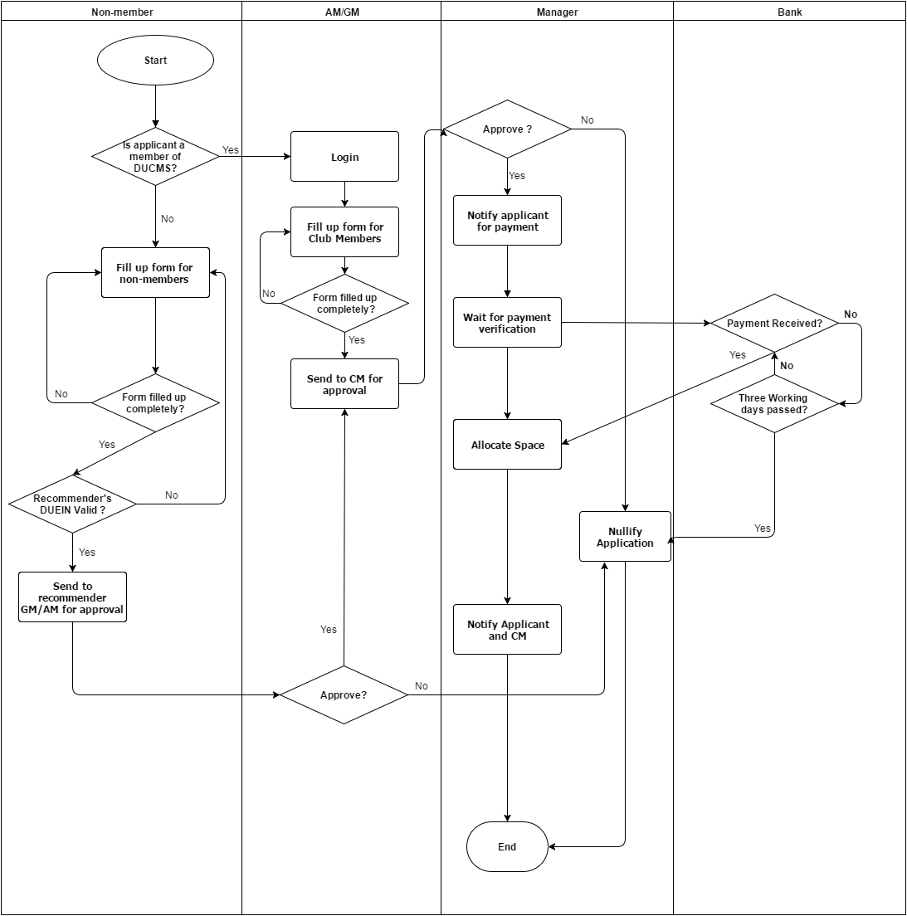
Swimlane Diagram 1.3:
Booking Space

Slide 24
Manager ACTIVITIES
Use Case Diagram
Scenario based modeling
Record transactions
Generate financial reports in real time
Add or remove food items
Change food detail of existing food item
Approve AM application and Booking Application
View Member List
Activity Diagram
Swimlane Diagram

Slide 25
Name: Managerial Activities ID: CMS-L-1.4 Primary Actors: CM Secondary Actors: DUAD, Bank, GM, AM, Non-member
Back

Slide 26
Activity Diagram 1.4:
Management Activities
Back

Slide 27
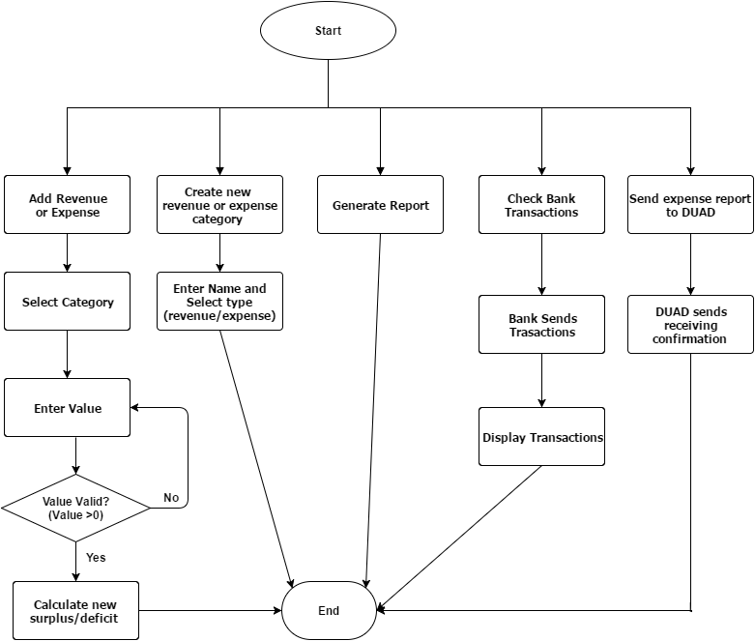
Activity Diagram 1.4.1:
Financial Management
Back

Slide 28
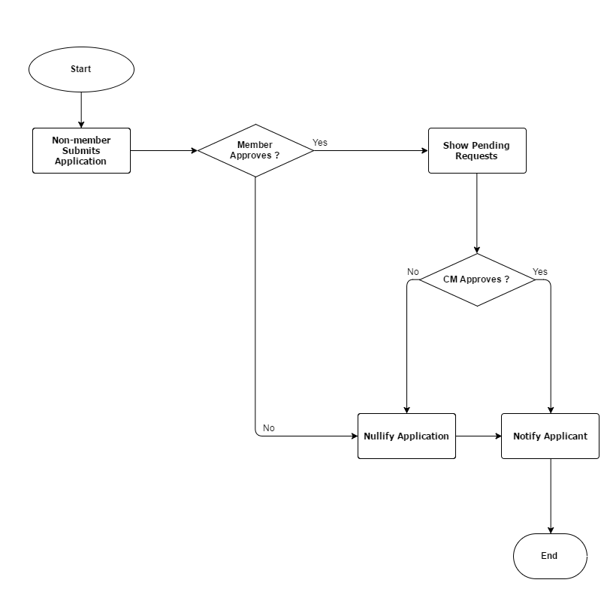
Activity Diagram 1.4.2:
Approve Pending Requests
Back

Slide 29
Activity Diagram 1.4.3:
Changing Food Detail
Back

Slide 30
Member ACTIVITIES
Use Case Diagram
Scenario based modeling
Members are able to access their real time expense report, their current month’s expense report and past year’s expense report at any given time.
Members are able to view a graphical list of food items served for every day of the week, can order food to eat and can rate food items according to their satisfaction. They can set an expense limit of a month.
members receive automated request to recommend, update their personal information and can set a two factor authentication.
Activity Diagram
Swimlane Diagram

Slide 31
Name: Member Activities ID: CMS-L-1.5 Primary Actors: AM,GM
Back

Slide 32
Activity Diagram 1.5.2:
Member Food Activities
Next

Slide 33
Activity Diagram 1.5.3:
Member System Activities
Back

Slide 34
Swimlane Diagram 1.5.1:
Member Financial Activities
Next

Slide 35
Data model

Slide 36
Data Object
To identify data objects –
Noun Identification
Identify Potential Data Object
Analysis for finalizing Data Objects
Final Data Objects Selection
Data model
PDF

Slide 37
Data model
Total Nouns : 137
Potential Data Objects : 26
PDF

Slide 38
Data model
Analysis for finalizing Data Objects
Member, CM and non-members are all users of DUCMS and hence have their common attributes stored as data object User.
AM, GM and CM are all members of DUCMS and hence have their common attributes stored as data object Member.
Additional attributes of GM are stored in GM data object. Additional attributes of AM are stored in AM data object.
Booking Application is submitted by booking applicant with additional attributes such as booking date, time and purpose.
Recommender is a member of the club.
PDF

Slide 39
Data model
Analysis for finalizing Data Objects (Contd.)
Details of food are stored in the Food data object. Menu is just a list of Food object.
Cart stores food ordered by a member with the help of data object food ordered. Order is cart submitted by member. Virtual Receipts are prior carts submitted by member. Hence these are represented altogether by Cart data object.
Food rating stores ratings of every food item given by every member.
Days served keeps track of which food item is served at a particular day of the week.
PDF

Slide 40
Data model
Analysis for finalizing Data Objects (Contd.)
Device stores the mac address of electronic devices and the table they are attached to. Electronic device is represented by Mac Address.
Transaction Category stores revenue/expense categories.
Bank Transaction is used to store data received from Bank.
Transaction stores financial transactions occurred while operating the club. Reports can be generated from Transactions and hence need not be stored.
PDF

Slide 41
Data model
Final Data Object
User
Member
GM
AM
Booking Applicant
Food
Cart
Food Ordered
Days Served
Transaction Category
Transaction
Food Rating
Bank Transaction
Device
PDF

Slide 42
Entity Relationship Diagram
Image

Slide 43
Class Based model

Slide 44
Class Based Model
Process of Class Based Model
Class Identification
Noun Parsing
General Classification
Selection Criteria
Class Finalization
Attribute Specification
Method Specification
Class Merging and Hierarchy
CRC Diagram
Generating Class Cards
Collaboration among Classes
PDF

Slide 45
Class Based Model
CRC v1.0

Slide 46
Class Based Model
CRC v2.0

Slide 47
Class Based Model
CRC v3.0

Slide 48
Registration
Attributes | Methods
Contact Number Application ID | receiveApplication() checkApplicationStatus() checkApplicantType() sendApplication() receivePaymentVerification() sendNotification() notifyManager()
Responsibilities | Collaborative Class
Receive Application | Application
Approve Application | Application, Member, CM
Verify Payment | Non Member, Member, Bank
Finalize Registration | Non Member, Member, CM
Class Card :
Registration
PDF

Slide 49
CRC Diagram of
DUCMS
PDF

Slide 50
Behavioral model

Slide 51
Behavioral model
All behavioral models really describe the control structure of a system. This can be things like:
Sequence of operations
Object states
Object interactions

Slide 52
Behavioral model
State Transition Diagram
First we identify the events list, their initiator class and collaborator class from Class Responsibility and Collaboration.
According to the events list we create the state transition diagram for all the classes. The diagram describe the activities of the classes.
We generate the sequential diagram combining the state of all classes according to the time line.
Sequential Diagram

Slide 53
State Transition Diagram:
Authentication
Next

Slide 54
State Transition Diagram:
Manager
Next

Slide 55
State Transition Diagram:
Food
Back

Slide 56
Q/A

Slide 57
Thank you

